Slide 1
CALENDAR

Slide 2
Calendar
Calendar
Introduction
Concept of odd days
Leap and non-leap years and centuries
Same calendar concept
Finding day on a given date
Miscellaneous questions
Data Sufficiency

Slide 3
Calendar
Counting odd
Odd days in an ordinary year: An ordinary year contains 365 days. On dividing 365 by 7, we get 1 as a remainder (52*7 +1) or (52 weeks + 1 day). It means an ordinary year has one odd day.
Odd days in a leap year: A leap year contains 366. On dividing 366 by 7, we get 2 as remainder (52*7 + 2) or (52 weeks + 2). It means a leap year has two odd days.
Odd days in a century: A century has 76 ordinary years and 24 leap years.
∴100 years = 76 ordinary years + 24 leap years
= [(76*52) weeks + 76 odd days] + [(24*52) weeks + 48 odd days]
= [(100*52) weeks + 124 odd days]
= (5200 weeks + 17 weeks + 5 odd days)
= (5217 weeks + 5 odd days)
∴A century or 100 years have 5 odd days.
Similarly, in 200 years, there will be 10 (5+5) days, 7 days (1 week) + 3 odd days. So, 200 years have 3 odd days.

Slide 4
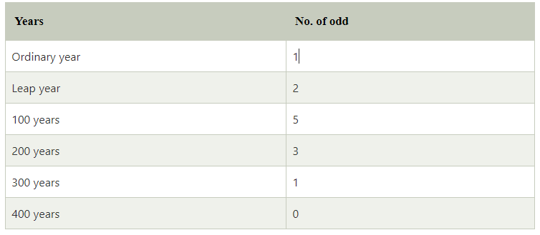
Calendar
Tables of odd
a.) Table showing the relation between the year and the number of odd

Slide 5
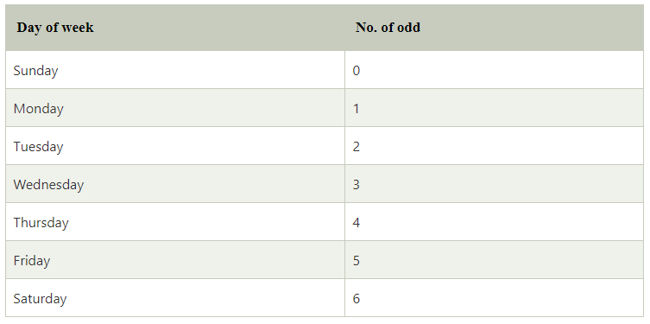
Calendar
b.) Table showing the relation between the day of the week and the number of odd

Slide 6
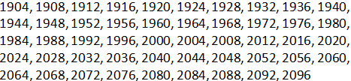
Calendar
Notes:
The years which are divisible by 400 have 0 odd days, e.g. 400, 800, 1200, 1600, 2000, etc.
Last day of a century cannot be Tuesday, Thursday or Saturday.
April & July for all years and January and October for non-leap years have the same calendar.
The calendars of two different years are same if they satisfy the following conditions;
a) The years must be of the same type, i.e. both must be either ordinary years or leap years.
b) January 21 of both the years, must be the same day of the week.
The leap years in the 20th and 21st centuries;

Slide 7
Calendar
Points to remember:
1. Problems on calendar mainly deal with finding the day of the week on a given date using the number of odd days.
2. Odd days: Odd days are different from odd numbers. They are the number of days more than the complete number of weeks in a given period.
3. To find the number of odd days divide the given number of by seven. The remainder left represents the number of odd days.
For example: if the given number of days is 80, after dividing 80 by 7, the remainder left is 3. Hence, there are three odd days.
Similarly, if the given number of days is 77, after dividing 77 by 7, the remainder left is 0. Hence, there are 0 odd days.
4. Ordinary year: A year which is not a leap year is called an ordinary year. It has 365 days.
5. Leap year: A year which is divisible by 4 is called a leap year, e.g. 1992, 1996, 2000, etc., are leap years. A leap year has 366 days. If the year is a century, it will be a leap year if it is divisible by 400, i.e. every 4th century is a leap year, e.g. 400, 800, 1200, etc., but 200, 500, 1900, etc., are not leap years.

Slide 8
Calendar
1.What is two weeks from today?
A]Same day B] Previous day
C] Next day D] None
Notes:
Option A) same day
Easy (Compulsory)

Slide 9
Calendar
2.How many days are there in k weeks k days ?
A]8+K DAYS B] 7+K DAYS
C] 8K DAYS D] 7/K DAYS
Notes:
Option C
Easy (Compulsory)

Slide 10
Calendar
3. How many weekends in a non-leap year?
A] 52 B] 53
C] 103 D] 104
Notes:
Answer: A) 52
Easy (Optional)

Slide 11
Calendar
4. What is the number of odd days in a leap year?
A] 1 B] 2
C] 3 D] 4
Notes:
Option B
Easy (Optional)

Slide 12
Calendar
5.If the third day of a month is Tuesday, which of the following would be the 25th day of that month?
A] Tuesday B] Monday
C] Wednesday D] Sunday
Notes:
Answer: C) Wednesday
Easy (Compulsory)

Slide 13
Calendar
6. Today is Wednesday, What will be the day after 27 days?
A] Monday B] Wednesday
C] Friday D] Tuesday
Notes:
Option D
Easy (Optional)

Slide 14
Calendar
7. Today is Wednesday, What will be the day after 62 days?
A] Monday B] Wednesday
C] Friday D] Tuesday
Notes:
Option D
Easy (Compulsory)

Slide 15
Calendar
8. Arnav's birthday is on Tuesday 14th March. On what day of the week will be Pranay's Birthday in the same year if Pranay was born on 13th September?
A] Monday B] Tuesday
C] Wednesday D] Thursday
Notes:
Option C
Moderate (Compulsory)

Slide 16
Calendar
9. Aniruddh's birthday is on Sunday 2nd April. On what day of the week will be Priyansh's Birthday in the same year if Priyansh was born on 28th October??
A] Saturday B] Wednesday
C] Friday D] Thursday
Notes:
Option A
Moderate (Optional)

Slide 17
Calendar
10. Priya's birthday is on Tuesday 11th April. On what day of the week will be Rani's Birthday in the same year if Rani was born on 31st August?
A] Monday B] Wednesday
C] Tuesday D] Thursday
Notes:
Option D
Moderate (Optional)

Slide 18
Calendar
11.If Feb 12th,1986 falls on Wednesday then Jan 1st,1987 falls on which day?
A] Wednesday B] Tuesday
C] Thursday D] Friday
Notes:
Answer: C) Thursday
Moderate (Optional)

Slide 19
Calendar
12.If 6th March, 2005 is Monday, what was the day of the week on 6th March, 2004?
A] Sunday B] Saturday
C] Tuesday D] Wednesday
Notes:
Answer: A) Sunday
Moderate (Compulsory)

Slide 20
Calendar
13.Given that on 9th August 2016 is Saturday. What was the day on 9th August 1616 ?
A] Saturday B] Sunday
C] Friday D] Monday
Notes:
Answer: A) Saturday
Expert (Compulsory)

Slide 21
Calendar
14.The maximum gap between two successive leap year is?
A]4 B]8
C] 2 D]1
Notes:
Answer: B) 8
Easy (Compulsory)

Slide 22
Calendar
15. Which of the following is not a leap year?
A] 800 B] 900
C] 1600 D] 2400
Notes:
Option B
Easy (Optional)

Slide 23
Calendar
16. How many leap years are there in 160 years?
A] 80 B] 90
C] 39 D] 40
Notes:
Option C
Moderate (Compulsory)

Slide 24
Calendar
17. How many leap years are there in between 2000 to 2160 years?
A] 80 B] 90
C] 39 D] 40
Notes:
Option D
Moderate (Optional)

Slide 25
Calendar
18. How many leap years are there in 900 years?
A] 219 B] 217
C] 225 D] 223
Notes:
Option A
Expert (Optional)

Slide 26
Calendar
19.The last day of a century cannot be
A] Tuesday B] Saturday
C] Thursday D]All of the above
Notes:
Answer: D)
Expert (Compulsory)

Slide 27
Calendar
20.From the given options, Which two months in a year have the same calendar?
A] October and December B] April and November
C] June and October D] April and July
Notes:
Answer: D) April, July
Easy (Compulsory)

Slide 28
Calendar
21. Which of the calendars would be same as that of the year 1907?
A] 1918 B] 1917
C] 1915 D] 1916
Notes:
Option A
Moderate (Compulsory)

Slide 29
Calendar
22. Which of the calendars would be same as that of the year 1965?
A] 1970 B] 1971
C] 1972 D] 1973
Notes:
Option B
Moderate (Optional)

Slide 30
Calendar
23. Which of the calendars would be same as that of the year 2028?
A] 2056 B] 2057
C] 2058 D] 2059
Notes:
Option A
Moderate (Compulsory)

Slide 31
Calendar
24. Which of the calendars would be same as that of the year 2032?
A] 2002 B] 2003
C] 2004 D] 2005
Notes:
Option C
Moderate (Optional)

Slide 32
Calendar
25. What was the day of the week on 20th May, 2007?
A] Sunday B] Monday
C] Tuesday D] Wednesday
Notes:
Option A
Moderate (Compulsory)

Slide 33
Calendar
26. What was the day of the week on 20th April, 1806?
A] Sunday B] Monday
C] Tuesday D] Wednesday
Notes:
Option A
Moderate (Compulsory)

Slide 34
Calendar
27. What was the day of the week on 01st Jan, 1996?
A] Sunday B] Monday
C] Tuesday D] Wednesday
Notes:
Option B
Moderate (Optional)

Slide 35
Calendar
28.On what dates of April, 2001 did Wednesday fall?
A] 2nd ,9th ,16th ,23rd B] 4th ,11th ,18th ,25th
C] 12th ,18th ,27th ,6th D] 1st ,8th ,15th ,22nd
Notes:
Answer: B) 4th,11th,18th,25th
Expert (Compulsory)

Slide 36
Calendar
29. If every seconds Saturday and all Sundays are holidays in a 30 days month beginning on Saturday, then how many working days are there in that month ? (Month starts from Saturday)
A] 25 B] 24
C] 22 D] 23
Notes:
Answer: D) 23
Moderate (Compulsory)

Slide 37
Calendar
30.Second & fourth Saturdays and every Sunday is a holiday. How many working days will be there in a month of 31 days beginning on a Friday ?
A] 24 B] 23
C] 22 D] 25
Notes:
Answer: A) 24
Moderate (Compulsory)

Slide 38
Data Sufficiency-Calendar
31. The Chairman of a big company visits one department on Monday of every week except for the Monday of third week of every month. When did he visit the Purchase department ?
Statements:
I. He visited Accounts department in the second week of September after having visited Purchase department on the earlier occasion.
II. He had visited Purchase department immediately after visiting Stores department but before visiting Accounts department.
A. if the data in statement f alone are sufficient to answer the question while the data in statement II alone are not sufficient to answer the question.
B. if the data in statement II alone are sufficient to answer the question while the data in statement I alone are not sufficient to answer the question.
C. if the data either in statement 1 alone or in statement II alone arc sufficient to answer the question.
D. if the data even in both statements I and II together are not sufficient to answer the question.
E. If the data in both statements I and II together are necessary to answer the question.
Notes:
Option A
Easy (Compulsory)

Slide 39
Data Sufficiency-Calendar
32. On which day in April is Gautam's birthday ?
Statements:
I. Gautam was born exactly 28 years after his mother was born.
II. His mother will be 55 years 4 months and 5 days on August 18 this year.
A. if the data in statement f alone are sufficient to answer the question while the data in statement II alone are not sufficient to answer the question.
B. if the data in statement II alone are sufficient to answer the question while the data in statement I alone are not sufficient to answer the question.
C. if the data either in statement 1 alone or in statement II alone arc sufficient to answer the question.
D. if the data even in both statements I and II together are not sufficient to answer the question.
E. if the data in both statements I and II together are necessary to answer the question.
Notes:
Option E
Easy (Optional)

Slide 40
Data Sufficiency-Calendar
33. If the first day of a month is Thursday, how many days were there in that month? Statements: I. The fourth Sunday happened to be on 25th. II. The last day of the month was the fifth Saturday of that month
A. if the data in statement f alone are sufficient to answer the question while the data in statement II alone are not sufficient to answer the question.
B. if the data in statement II alone are sufficient to answer the question while the data in statement I alone are not sufficient to answer the question.
C. if the data either in statement 1 alone or in statement II alone arc sufficient to answer the question.
D. if the data even in both statements I and II together are not sufficient to answer the question.
E. if the data in both statements I and II together are necessary to answer the question.
Notes:
Option B
Easy (Compulsory)

Slide 41
Data Sufficiency-Calendar
34. On which date in March was Pravin’s father’s birthday ?
Statements:
I. Pravin Correctly remembers that his father’s birthday is after 14th but before 19th March.
II. Pravin’s sister correctly remembers that their father’s birthday is after 17th but before 21st March
A. if the data in statement f alone are sufficient to answer the question while the data in statement II alone are not sufficient to answer the question.
B. if the data in statement II alone are sufficient to answer the question while the data in statement I alone are not sufficient to answer the question.
C. if the data either in statement 1 alone or in statement II alone arc sufficient to answer the question.
D. if the data even in both statements I and II together are not sufficient to answer the question.
E. if the data in both statements I and II together are necessary to answer the question.
Notes:
Option E
Easy (Optional)

Slide 42
Any Doubts???

